Slide 1
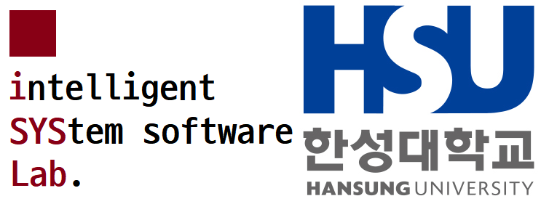
Spiking Neural Networks Support in ONNX Runtime
Seonmin Kim,
Hansung University

Slide 2
Contents
ONNX, Protobuf
ONNX Runtime
Scikit-learn to ONNX
Scikit-learn vs ORT Operators Benchmarks
Keras to ONNX
ONNX-SNN

Slide 3
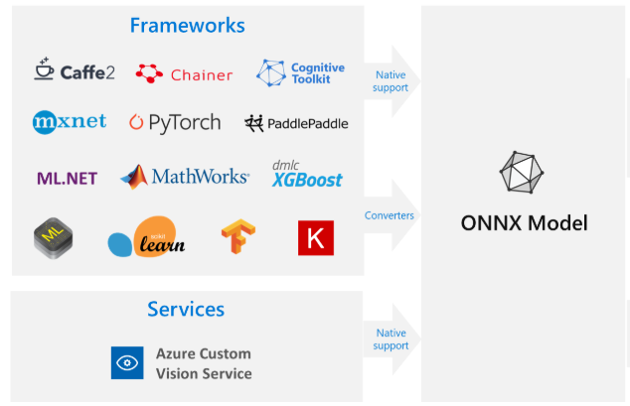
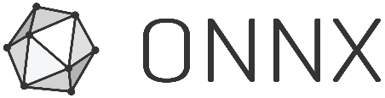
1. ONNX, Protobuf
ONNX (Open Neural Network Exchange)– AI framework learning model format standardization
Support various types of DL and ML Frameworks
Definition using Google protobuf
ONNX operator
https://github.com/onnx/onnx/blob/master/docs/Operators.md
Onnx-ml operator
https://github.com/onnx/onnx/blob/master/docs/Operators-ml.md
출처 : https://docs.microsoft.com/ko-kr/azure/machine-learning/concept-onnx
Notes:
Onnx ml 연산자는 machine learning 으로 된 onnx 모델을 읽어들여서 추론을 할 때 그 연산 계산을 대신 해주는 것.

Slide 4
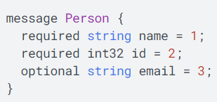
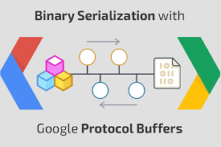

1. ONNX, Protobuf
Serialized data structure developed by Google and published as open source
Supports various languages such as Java, Python, js, Ruby, Go
Fast serialization speed and small serialized file size
** Serialization : The act of saving data as a file or in the form of a binary stream for transmission over the network
- Example of Protobuf message -
출처 : https://oracle-patches.com/en/data-science/4010-protocol-buffers-brief-description

Slide 5
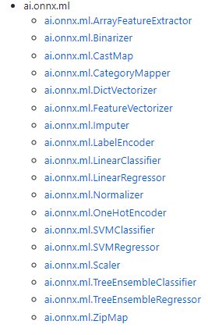

2. ONNX Runtime(ORT)
ONNX Runtime is an engine for inference for machine learning models in ONNX format.
The main purpose is to improve inference performance of various ML/DL models, and CPU/GPU during inference
Latest Release Note. July 20 – 1.4.0 : Support model Training in pytorch
Using ONNX operator and ONNX-ml operator
In addition to the commonly known OneHotEncoder and Normalizer, onnx-ml operators such as CastMap and ZipMap exist, and these help more efficient operation.
- ONNX-ML Operator -

Slide 6
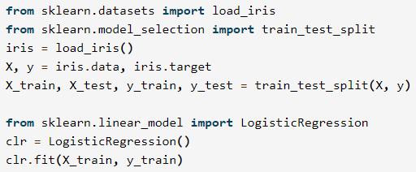
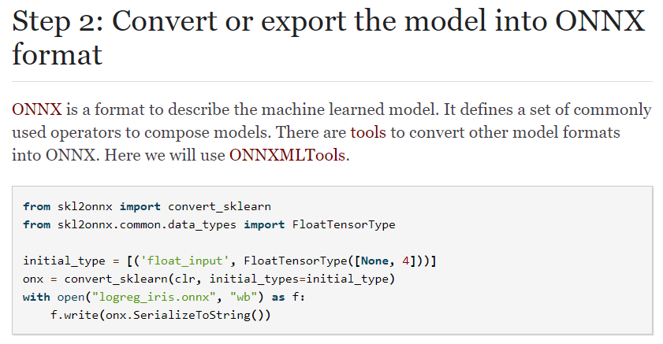

3. Scikit-learn to ONNX ( ONNX-ML )
Scikit-learn supports various machine learning algorithms such as Python-based machine learning library, Classification, Regression, Clustering, and Decision Tree.
Models made with scikit-learn can be converted to onnx format using the sklearn-onnx package.
1. Iris data learning Logistic Regression model creation
2. Onnx model transformation through Sklearn-onnx

Slide 7
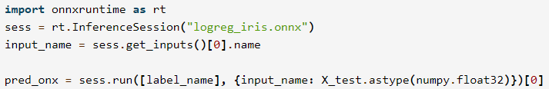
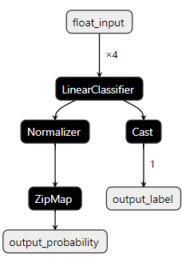
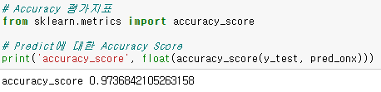
3. Scikit-learn to ONNX ( ONNX-ML )
Scikit-learn supports various machine learning algorithms such as Python-based machine learning library, Classification, Regression, Clustering, and Decision Tree.
Models made with scikit-learn can be converted to onnx format using the sklearn-onnx package.
3. Inference using Onnx Runtime
4. Visualizatin of .onnx models through Netron (ML)

Slide 8
4. Scikit-learn vs ORT Operators Benchmarks
Scikit-learn
All scikit-learn operations are backed by Numpy
Numpy’s linear algebra library (BLAS, LAPACK)
OnnxRuntime
Numpy Operation method andONNX-ml operator
For certain task operations, results are better than Numpy-based operations
OnnxRuntime
In the case of ai.onnx ‘add’ operation, similar results are shown in Scikit-learn and onnx-runtime
In the case of ai.onnx-ml ‘Scaler’ operation shows better performance in onnx-runtime than Scikit-learn
Reference: http://www.xavierdupre.fr/app/_benchmarks/helpsphinx/onnx/onnxruntime_unittest.html
Notes:
=>둘다 numpy기반으로 돌아가며, onnxruntime은 추가적으로 onnx-ml을 활용 / 나름의 최적화를 한 것? Zipmap이나, castmap은 실제 scikit-learn에는 존재하지 않는 것임. / 추가적으로 뒤에 있는 scaler부분도 공통적으로 있지만 차이가 있음. / 그 소스코드를 직접열어서 최적화가 어떻게 됬는지 직접 비교해보려고 했으나 너무 난해해서 못함.

Slide 9
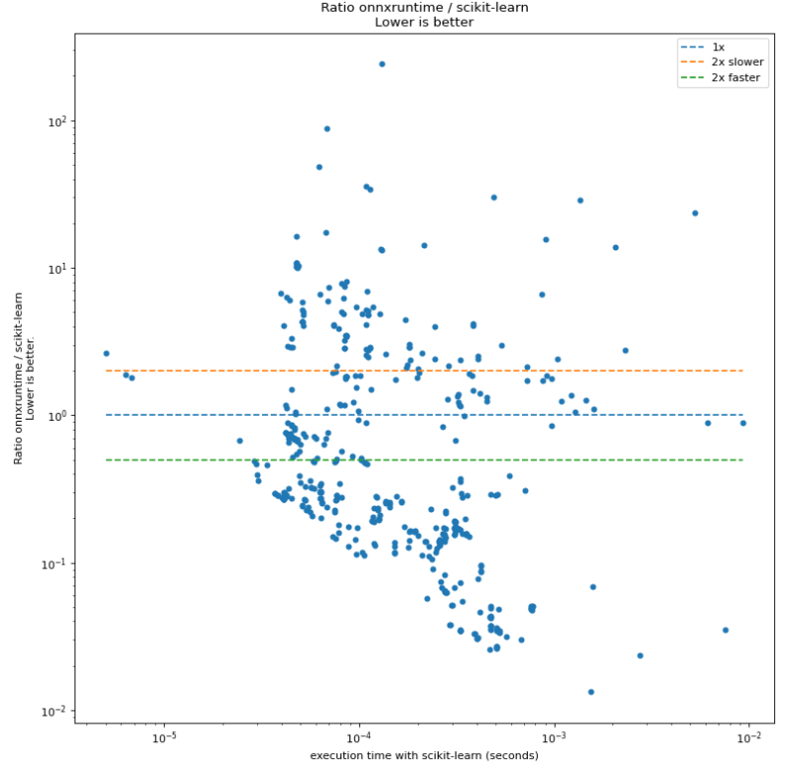
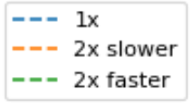
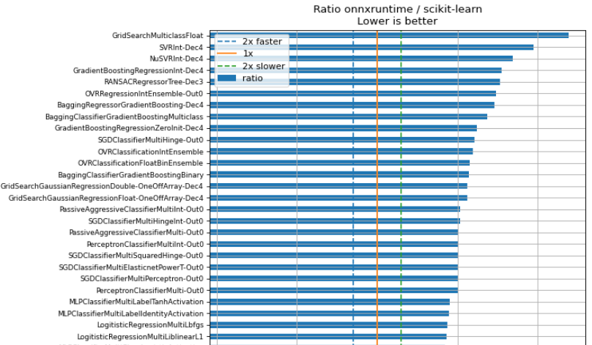
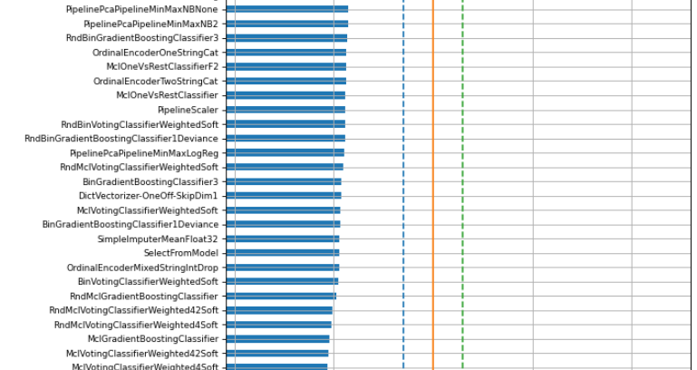
4. Scikit-learn vs ORT Operators Benchmarks
…
2x faster than Scikit-learn
출처 : http://www.xavierdupre.fr/app/_benchmarks/helpsphinx/
onnx/onnxruntime_unittest.html
Notes:
- 파란색선은 동등한 것
아래쪽으로 갈수록 onnxruntime이 더 좋은 성능을 보이는 것,
초록색선은 scikit-learn보다 2배 이상 빠른 것
위쪽으로 갈수록 scikit-learn이 onnxruntime보다 더 좋은 성능을 보이는 것,
주황색 선은 onnxruntime보다 2배 이상 빠른 것
결론 : 어쨌이든 차이가 있다고 함.

Slide 10
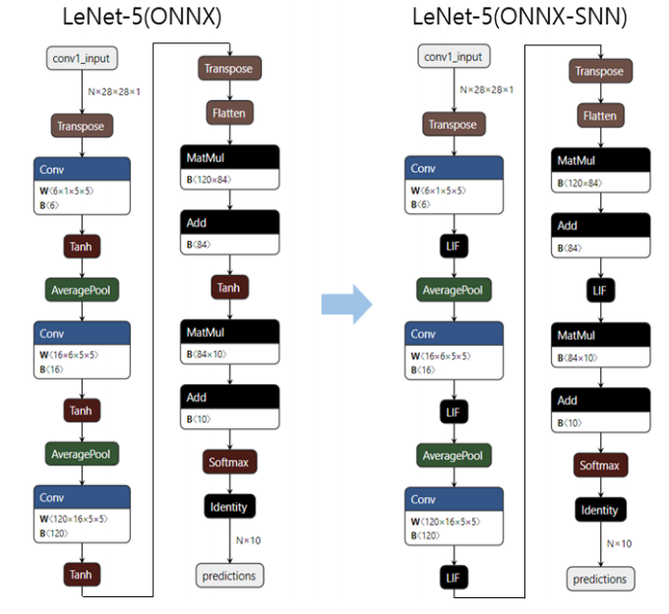
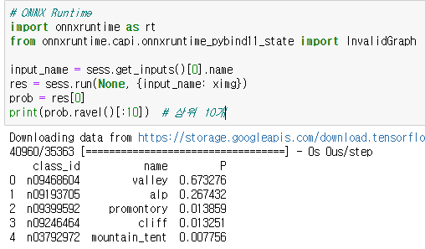
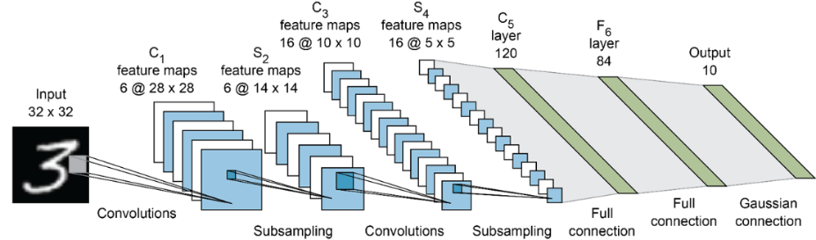
5. Keras to ONNX ( ONNX-DL )
Keras is an easy and concise deep learning library implemented in Python
Keras2Onnx package can be used to convert keras model to ONNX Model
The converted .onnx model consists of ONNX operators
- CNN based LeNet-5 model -
- Inference using Onnx Runtime -
- Visualization of oonx moel through Netron (DL) -

Slide 11
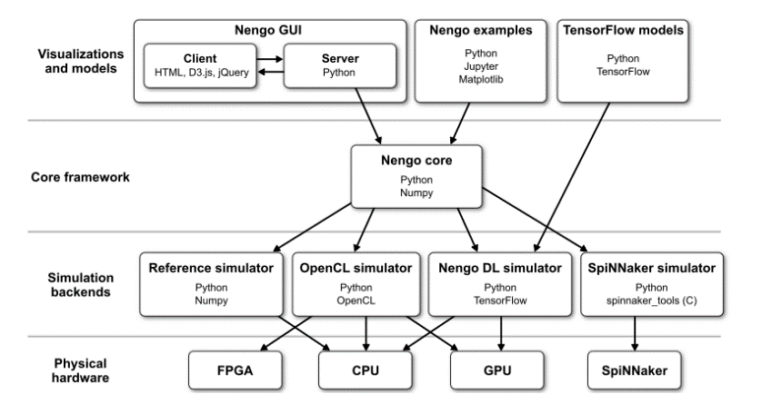
6. ONNX-SNN
SNN(Spiking Neural Network) reflects the working flow of neurons in the actual brain of each neuron (Output value is emitted only when above a certain potential)
Nengo framework can simulate snn model and Nengo-dl can simulate Nengo network using Tensorflow
(1st year) DNN -> ONNX -> ONNX-SNN model can be converted using by Nengo (SNN support) package
(2st year) Nengo-supported operations (ex. LIF Activation) implemented as ONNX Runtime operator (in progress)
Finally, Model inference in the ONNX-SNN format is possible through ONNX Runtime
DNN
ONNX-
SNN
ONNX
Runtime
Inference
-Nengo , Nengo DL -
- ONNX-SNN Flow -
- ONNX-SNN -

Slide 12
Thank you

